Slide 1
ICT Programming
Lesson 1:
Introduction to Programming

Slide 2
Objectives
4.1.1: Define ”programming,” and discuss its role in computing.
4.1.2: Explain the binary representation of data and programs in computers.
4.1.3: Distinguish among the three types of programming languages (machine, assembly, high-level), and give examples.
4.1.4: Compare and contrast languages that are usually compiled (e.g., C++, Java) and interpreted (e.g., JavaScript, Python).
4.1.5: Describe the structure of a simple program, and explain why sequencing is important.
4.1.6: Write a program design document using pseudocode that shows program flow.

Slide 3
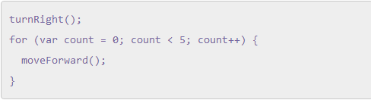
What is Programming?
Programs consist of instructions that tell the computer what to do
Programmer is a person that writes programs
Programming is the process of writing a computer program
Programming language is a set of key words and syntax (rules) for how to organize the instructions.

Slide 4
Computers
Computer: a machine that can perform a task independently
Needs a program that tells it what to do
Executing: when a computer runs a program and performs the tasks instructed by the program
Primary functions a computer performs:
Storing, retrieving, and displaying data
Calculates & manipulates data
  Adding, multiplying, comparing & moving data

Slide 5
Programming Languages: Machine
Machine language: the elemental language of computers made up of a long sequence of binary digital zeros and ones (bits)
The only language a computer understands
Transistor: an electrical switch that is either off (0) or on (1)
Bits: the on or off switch
Byte: eight bits
Base: 2 (0,1)

Slide 6

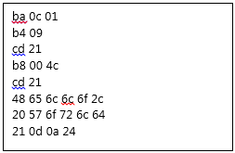
Binary & Machine Language
Binary code: “Hello, World!”
Machine language: “Hello, World!”

Slide 7
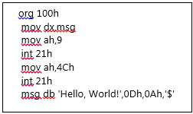
Assembly Language
More human-like representation of machine language
Uses symbols and recognizable code
Unique to different computers / operating systems
Difficult to write
Assembly language: “Hello, World!”

Slide 8
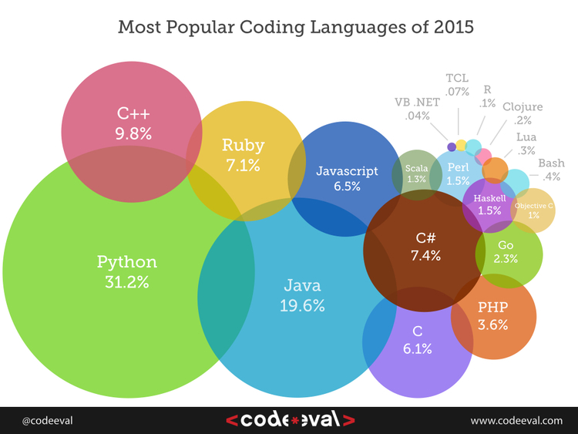
High Level Language
Programming languages with unique rules (syntax) and can be written without regard of computer running it
Usually use English words and phrases and easily recognizable symbols
Languages people usually write programs in
Python, C++, Visual Basic, Java, Perl, PHP
Must be translated into machine language before they can be run

Slide 9
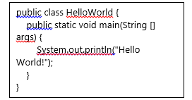

High Level Languages
“Hello, World!” in Java
“Hello, World!” in Python
“Hello, World!” in Scratch

Slide 10
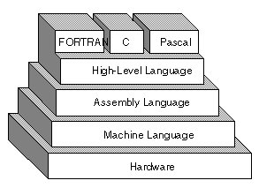
Compiled & Translated Code
Compiled languages: Translate entire program before the computer runs it
  Usually faster than translated
Translated language / Interpreter: translates a number of program instructions, waits for the computer to execute them, and then translates the next series, until the program is fully executed

Slide 11
Structured Programming
Works from the top to bottom
Designed by breaking problems into smaller, logical problems to make them easier to execute
Allows programmers to re-use portions of code and makes it easier to correct errors.

